Slide 1
Introduction to
Cloud computing
Module 1
Dr Bijoy A Jose

Slide 2
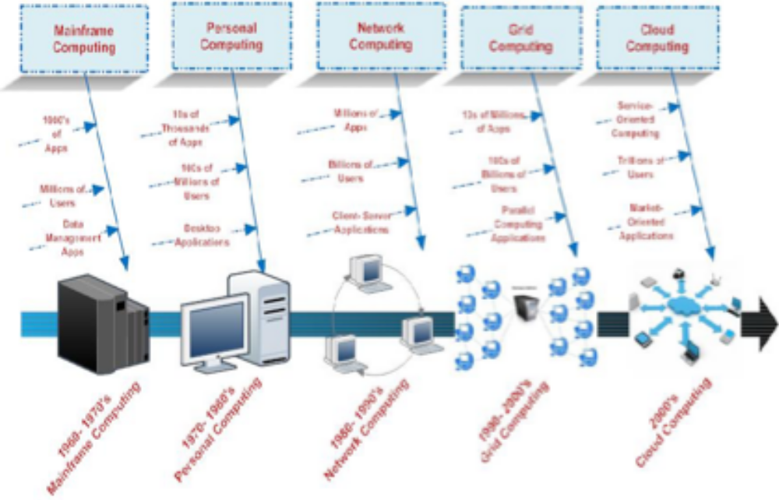
Evolution of computing

Slide 3
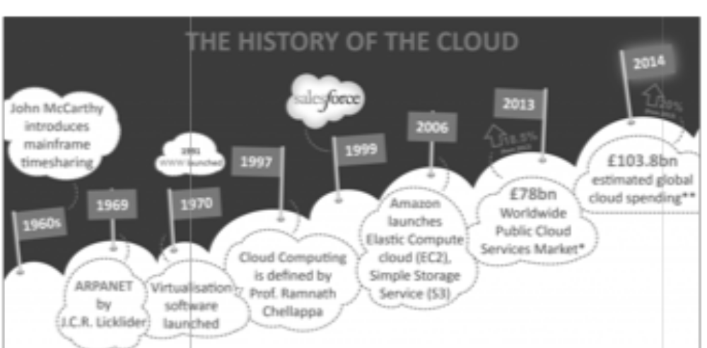
History of cloud computing

Slide 4
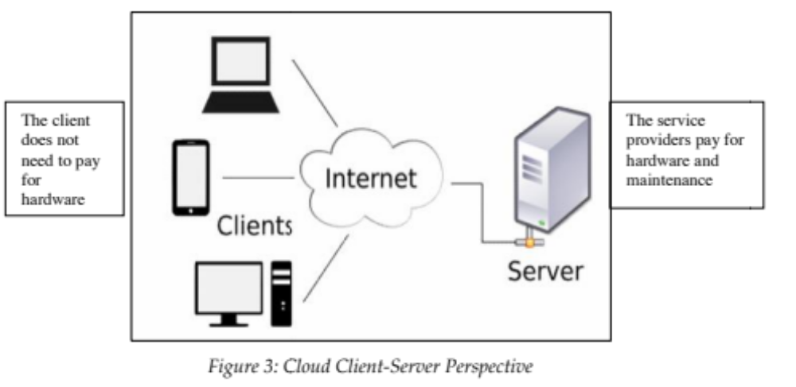
Client – server model

Slide 5
Mainframes

Slide 6
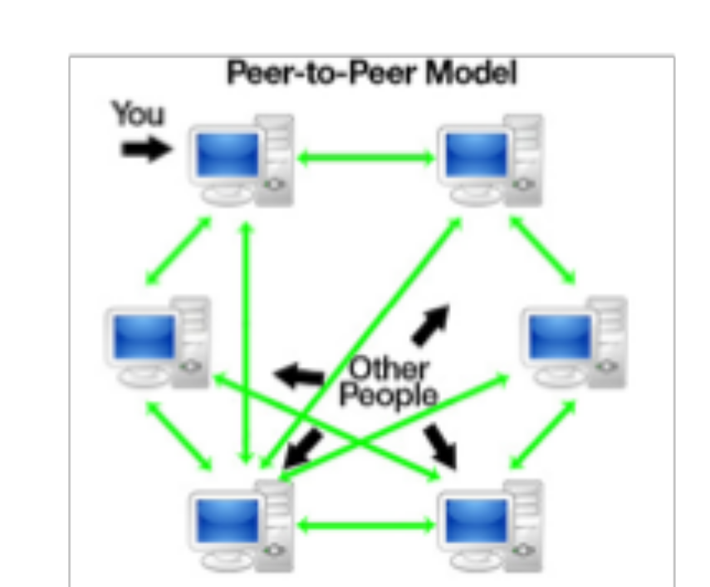
Peer to peer models
There is no central control in a distributed system behind peer to peer. Usually every node is called a peer.
The fundamental idea is that at a certain time each node can be a client or a server.
If something is asked from the node, it could be referred to as a client and if something arrives from a node it could be referred to as a server.

Slide 7
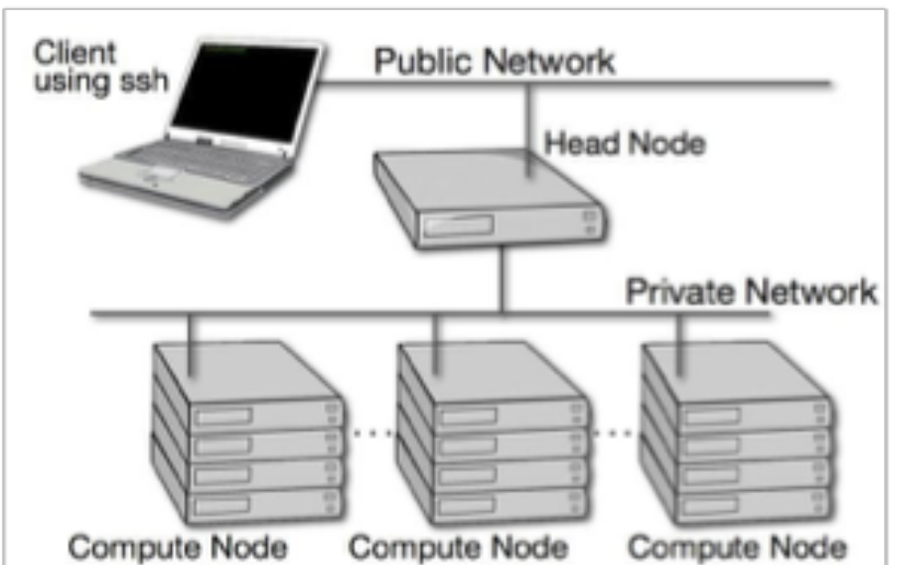
Cluster computing
Connects some computer nodes via a fast (LAN) network.
Computing node activity coordinated by the software "clustering middleware," a software layer situated in front of nodes that enables the users to access the cluster as a whole by means of a Single system image concept.
A cluster is a type of computer system that is parallel or distributed and which consists of a collection of interconnected independent computers, working together as a highly centralized computing tool that integrates software and networking with independent computers in a single system.
Clusters are usually used to provide greater computational power than can be provided by a single computer for high availability for greater reliability or high performance computing.

Slide 8
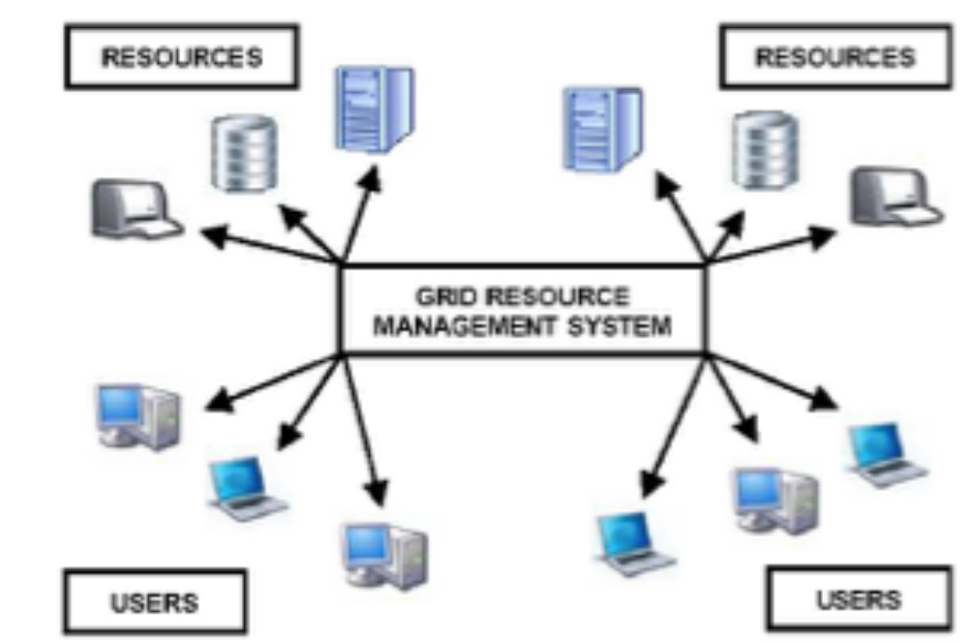
Grid computing
It is a processor architecture that combines computer resources from different fields to achieve the main purpose.
The network computers can work together on a work task in grid computing and therefore work as a super-computer.
A grid works on several tasks in a network, but can also work on specific applications.
A grid operates on different network tasks, but it can also operate on specific applications. It is intended to solve problems that are too large for a supercomputer and to retain the ability to handle several small problems.
Computing grids have a multi-user network that meets discontinuous information processing requirements.

Slide 9
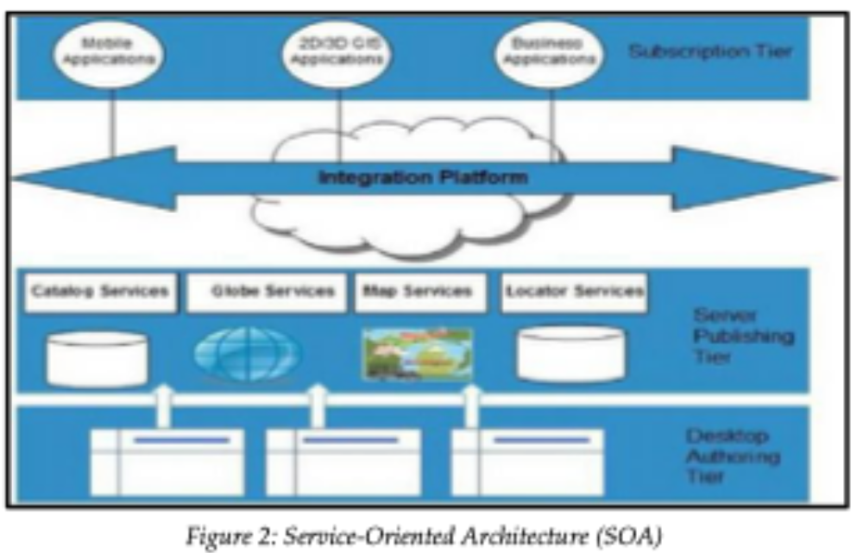
Service oriented architecture
Use applications as a service for other applications regardless the type of vendor, product or technology.
Therefore, it is possible to exchange of data between applications of different vendors without additional programming or making changes to services.
Airline industry
Shipping industry
Etc.

Slide 10
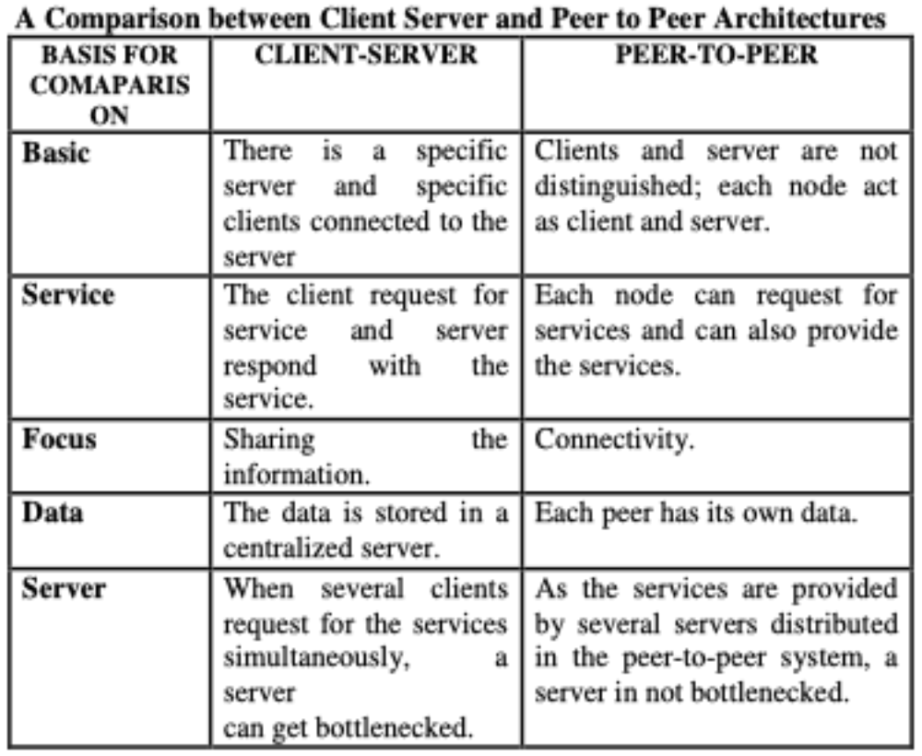
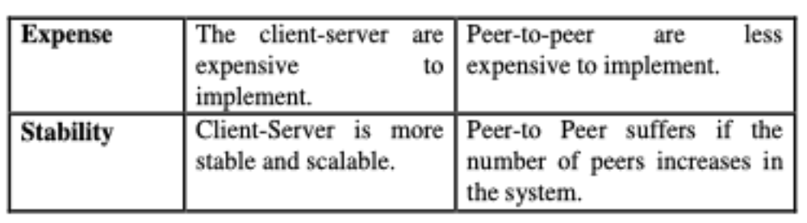
Client Server vs Peer to Peer

Slide 11
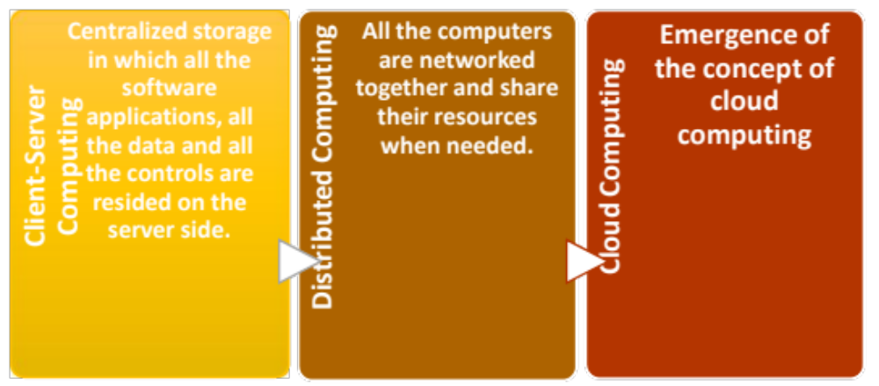
Cloud computing: origins

Slide 12
What is cloud computing?
Cloud computing is Internet-based computing, whereby hardware and software resources are provided to users on-demand.
It is a by-product and consequence of the ease-of-access to remote computing sites provided by the Internet.
Through cloud computing, you are able to use software delivered through the Internet on the browser without any installation, host an application on the Internet, set up your own remote file storage and database system and more

Slide 13
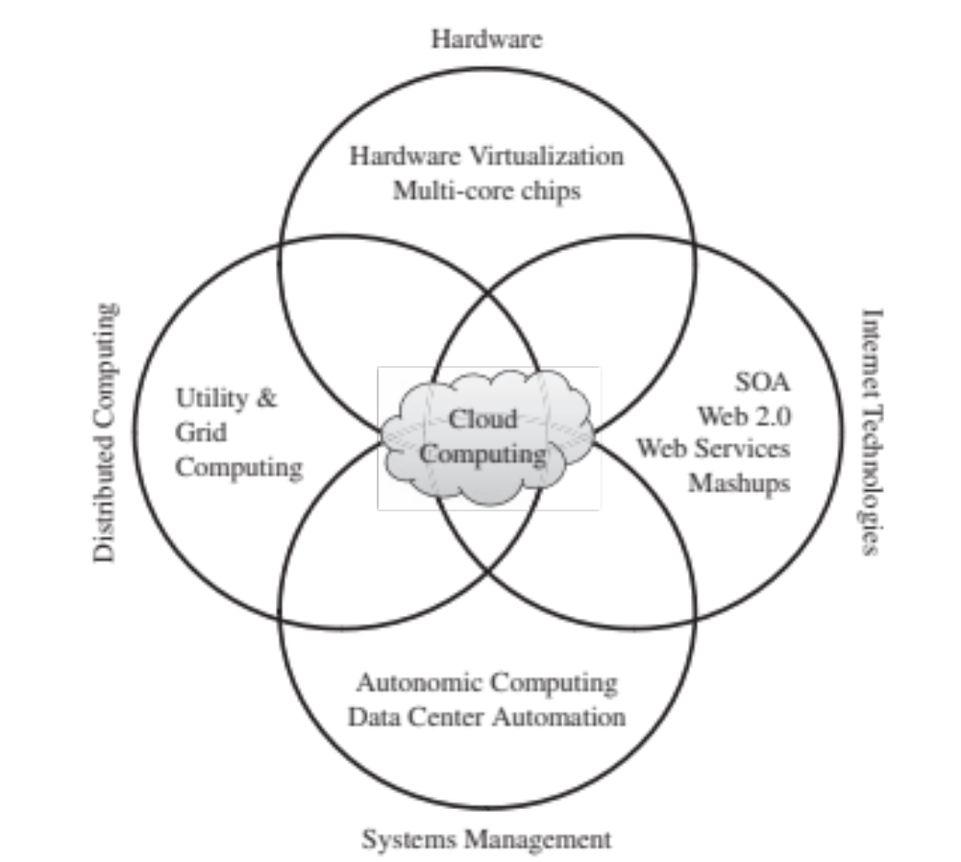
Cloud computing

Slide 14
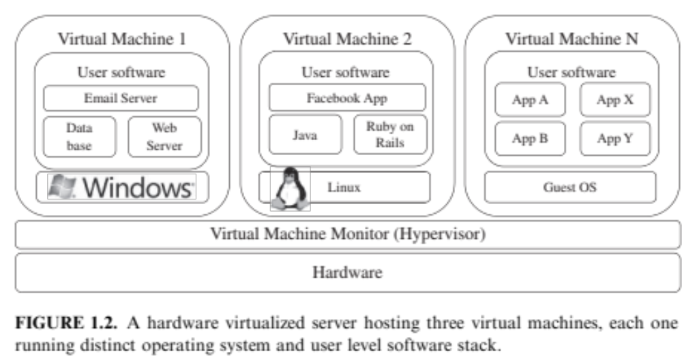
Cloud computing

Slide 15
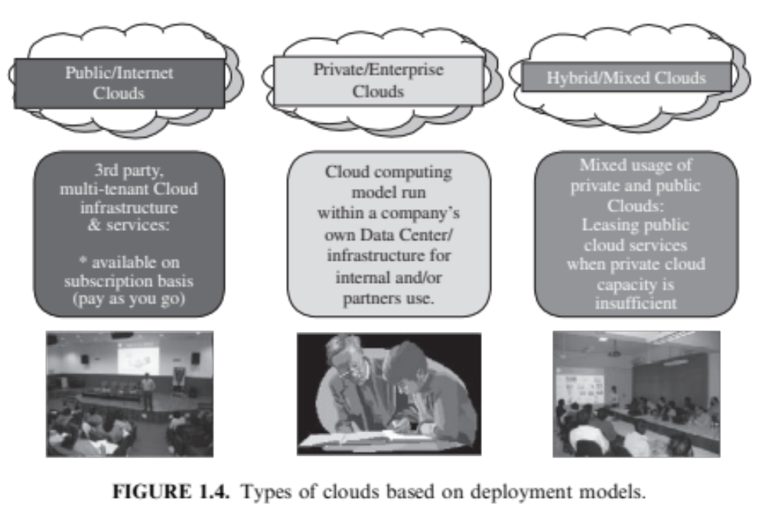
Types of Clouds

Slide 16
Principles of cloud computing
Resource pooling: Cloud computing providers harness large economies of scale through resources pooling. They put together a vast network of servers and hard drives and apply the same set of configurations, protection and the works for them.
Virtualization: Users do not have to care about the physical states of their hardware nor worry about hardware compatibility.
Elasticity: Addition of more hard disk space or server bandwidth can be done with just a few clicks of the mouse on-demand. Geographical scalability is also available in cloud computing - one can choose to replicate data to several data centres around the world.
Automatic/easy resource deployment: The user only needs to choose the types and specifications of the resources he require and the cloud computing provider will configure and set them up automatically.
• Metered billing: Users are charged for only what they use

Slide 17
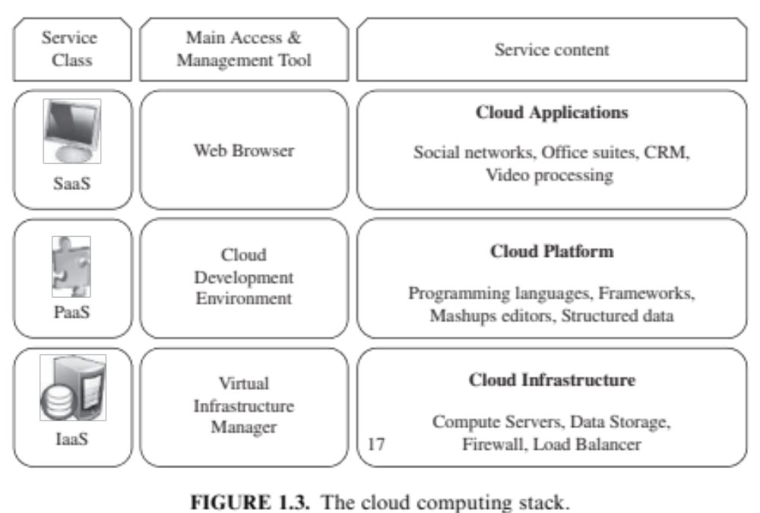
Cloud Computing stack

Slide 18
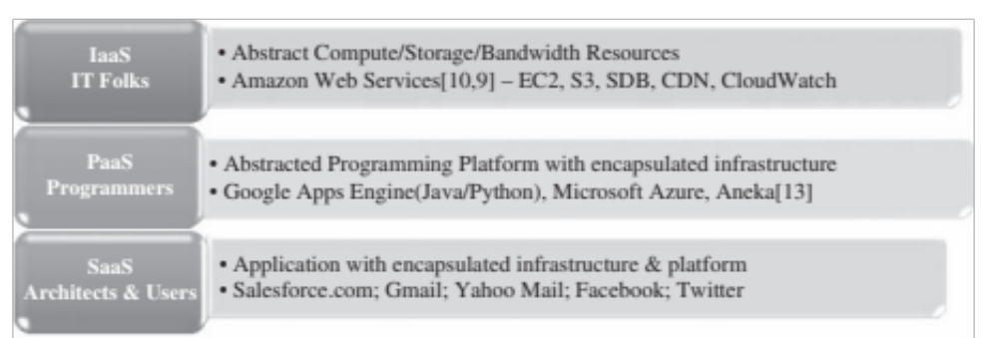
Examples of Computing services

Slide 19
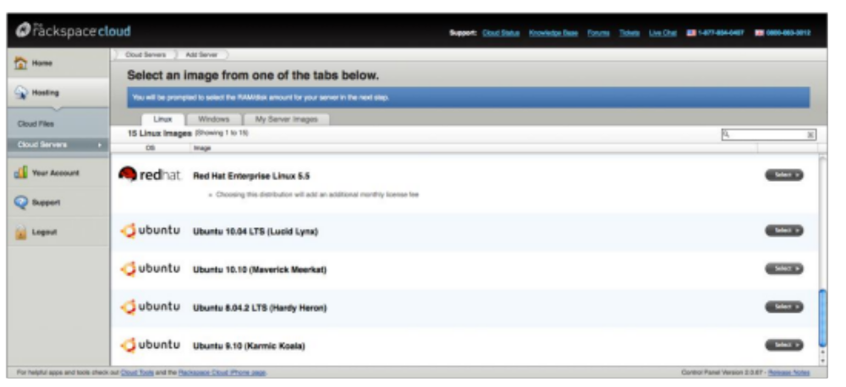
Eg: Rackspace provisioning an OS

Slide 20
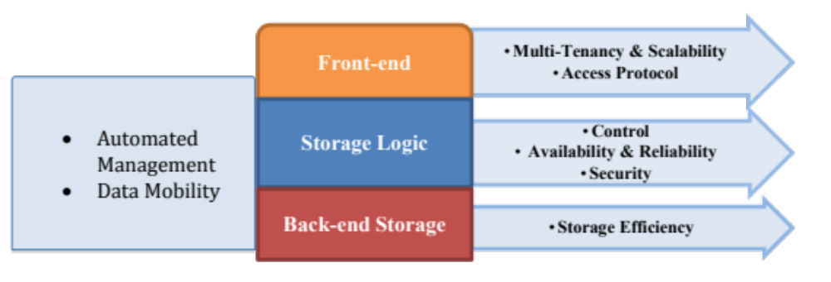
Three layered architecture
Availability has two dimensions:
Horizontal availability - that describes the regional spread that a service is hosted on
Vertical availability - that describes the resilience a service has against a large amount of traffic in a localised region
Multi-tenancy, which refers to the ability for a single instance of services to serve multiple clients or tenants, also applies to several different layers of the cloud storage stack and this allows numerous clients to subscribe to the same cloud computing capabilities while retaining privacy and security over their sensitive data.

Slide 21
Three layered architecture
With traditional file hosting, files are typically stored on one server hence clients who are far away from that server will suffer from bad performance. With cloud storage, there are 2 levels of geographical scalability. Firstly, the file is distributed around multiple servers in the region where your original data is stored at. Secondly, there are on-demand CDNs (content delivery networks). These are networks that have servers distributed globally to allow fast content delivery to clients anywhere in the world
hardware failures are inevitable and could be devastating if backups were not adequate. Cloud providers generally use two different approaches to ensure reliability.

Slide 22
Cloud computing: Advantages
Cost efficiency: pay as you go
High speed: Fast deployment and use
Excellent accessibility: regardless of machine
Backup and restore: Better than on-premise in safety
Manageability: Seamless IT updates due to SLA
Batch processing: Less congestion for processing during day
Less upfront costs

Slide 23
Cloud computing: Disadvantages
Vulnerability: Security breach monitoring
Network dependent:
Downtime: not in client control
Vendor lock-in: Public cloud managed technologies
Limited Control

